Slide 1

Anderson School
Home of the Trojans
Student and Family Handbook
2025-2026

Slide 2
ANDERSON PUBLIC SCHOOL
2195 Anderson Rd.
Sand Springs, Ok 74063
Anderson Public School is a dependent school district located in Osage County.
Mission Statement
The mission of Anderson School is to provide an environment in which every child has an opportunity to achieve at his/her highest potential. This opportunity will empower all students to succeed in an ever-changing world.
    Core Values
        Our students will know they are SAFE
        Our students will know they are LOVED
        Our students will gain MARKETABLE SKILLS
        Our students will become LIFE-LONG LEARNERS
Anderson School Board
Sharon Quimby
Kristen Duncan
Melissa McClain
Administration
Tod Williams - Superintendent
Leslie Fairchilds - Principal
Becky Ruff - Counselor
Todd Muskrat - Athletic Director

Slide 3

Student Resource
Community Resources and Tipline
For links and phone numbers to state and national hotlines, visit the Oklahoma State Department of Education’s website.
https://sde.ok.gov/help-hotlines
Help with school supplies, food, utilities, clothing, and other basic needs.
Sand Springs
Community Services
(918)245-5183
https://sscsok.org/
DHS
Statewide Abuse
&
Neglect Hotline:
1-800-522-3511
We are ALL responsible for the safety of our school students, school staff, and school community. If you are aware of unsafe situation or that a crime might occur, do not be reluctant to report.
It is the policy of the Anderson School District to prohibit all bullying, harassment, or threatening behavior of any person at school, on school grounds, school vehicle, and school sanctioned activities. Prohibited conduct includes incidents of bullying instigated by use of electronic communication specifically directed at students or school personnel. (School Safety and Bullying Prevention Act ,70 O.S. §§ 24-100.4 and 24-100.5) See policy FNCD, FNCD-R, and FNCD-P

Slide 4
ANDERSON PUBLIC SCHOOL 2195 ANDERSON RD. SAND SPRINGS, OK 74063 Acknowledgement of Review of the Student and Family Handbook Please return to your child’s teacher.
Please review the Student Handbook with your child. His/her teacher has discussed it in class, especially the Shield of Success and Student Code of Conduct, plus other policies and regulations it references that are an important part of a school career. Supporting a safe and secure learning environment is central to success in school. There will be periodic reviews of important sections of the handbook during the year, in particular sections related to:
Student Code of Conduct
Academics
Attendance
Dress Code
Technology Resources
In order for students to succeed in school and the community, it is essential that school and families work together. Home support is vital in helping Anderson students meet successful behavior expectations outlined in the Shield of Success and Student Code of Conduct.
As the parent/guardian of ________________________________________, I have read and discussed the Student Handbook. I understand that it and the policies and regulations it references apply to all students, at all times on all Board of Education property, including school buildings and on school grounds, in all school vehicles, and at all school-related or Board-sponsored activities, including but not limited to, school field trips and school sporting events, whether such activities are held on school property or at locations off school property, including private business or commercial establishments.
After you have reviewed the Student Handbook with your child, please sign and return this form to your student’s teacher.
Parent/Guardian Signature Date
Parent/Guardian Signature Date

Slide 5
Introduction
We promote a safe, supportive, and orderly learning environment. We encourage appropriate behaviors by teaching, guiding, directing, and providing opportunities to practice and succeed at making responsible, effective choices that promote academic and social skill sets.
School safety and academic success are created and strengthened when students are effectively and actively engaged in their learning. These outcomes are accelerated when positive relationships exist between students and school staff, and when families, communities, and school staff work collaboratively to support positive student outcomes.
Students have rights and privileges as well as responsibilities. While the school system has an obligation to provide an education for all students, we have set high standards for students to conduct themselves in a way that is respectful and helps to build a climate essential for learning. Students can expect school staff to reinforce positive behaviors.
This handbook outlines policies and procedures that promote a school atmosphere of excellence in teaching and learning.
The purpose of the handbook is:
Outline district policies and procedures and provide a resource guide for students and families regarding school practices.
To describe the Academic Process, Student Code of Conduct, and consequences that may be enforced upon violation of policies.
To illustrate expected student behaviors.
Anderson School district policies and practices promote respect through positive behavior choices, character development, and development of self-control.
Developing positive and effective student behaviors requires collaborative efforts from school, home, and community organizations and agencies.
Anderson School cultivates a learning climate focused on sustaining strategies proposed for achieving maximum academic success and positive social-emotional learning outcomes. This is achieved through diverse practices, with emphasis on Positive Behavioral Intervention & Supports (PBIS) and Response to Interventions (RtI). PBIS is a proactive approach to school-wide discipline that focuses on creating a positive environment through the practice of expected behaviors in the school community. PBIS uses a collaborative team approach to analyze data and respond to discipline-related behavioral patterns. RtI is a collaborative team approach that utilizes academic data to support and develop interventions relevant to student success.
The focus of this handbook is to guide students and families towards school climate success. The rules and expectations outlined have been developed so a combination of consistent and fair strategies will be implemented within the school community.

Slide 6
Student Enrollment
Enrollment and Transfer Process
Enrollment
Please bring all listed items and any necessary legal documentation for your student during the time of enrollment. If you are unsure or missing information, contact the Student Information Secretary for assistance in the enrollment process.
Enrollment need items:
Birth certificate
Photo ID of custodial parent
Immunization records: must have the necessary immunizations, as required by Oklahoma Law
Evidence of residence in the district: recent utility bill, receipt of paid county property tax (must be in parent/guardian’s name)
The following contact information:
  Parent’s home, work, and cell phone numbers
  Friends’/relatives’ phone number (emergencies)
  Parent email address
Name and address of the last school attended
Certificate of Indian Blood (CDIB) card, if available and enrolling as Native American
District Transfers
If you reside outside of the Anderson School district you must complete a Student Transfer Application Form forms are located on our website https://www.andersontrojans.org/page/transfer-forms . As a reminder, all forms must be completed in full in order to be considered for transfer. Transfer students will have to wait for approval based on our in-district student enrollments. If your student is a transfer into Anderson, you will go ahead and complete the online enrollment process during the dates listed above as well as the Student Transfer Application form.
For more information see policy FD, FD-R, FD-P, FE and FEH upon request.

Slide 7
Student Enrollment
Withdrawal Process
Please notify your child’s teacher and the Student Information Secretary as soon as possible in the event that your child will no longer be attending Anderson School.
All textbooks and workbooks must be returned to the classroom teacher.
Library books must be returned to Media Center.
If you desire copies of school records to take with you, notify the Student Information Secretary at least three days prior to withdrawal.
Student Attendance
Key to School Success
Attendance is a very important part of your child’s school career, education funding, and your school’s report card. At Anderson, we are serious about teaching students and families how to practice a foundation for school success. A major part of that success starts with attending school daily, and on time. Good school attendance is a character trait that helps build positive citizenship skills in students, families, staff, and community.
If you find your family struggling with getting your student to school daily or on time, please contact the School Office.
We are committed to helping students and families with school success!!!
School Day:
Start time: 8:00
Dismissal 3:15
As part of Anderson’s initiative to create a more proactive environment in the school community, please understand student attendance is extremely important and directly associated with state funding.

Slide 8
Student Attendance
Policy and Procedure
Early Arrival/Dismissal
Students should not arrive before 7:40 A.M.
Early pick up of students is reserved for emergencies and occasional doctor appointments. Early pickup on a daily basis is NOT permitted.
If a parent/guardian needs to take a student away from the school grounds for a doctor/dentist appointment, etc. the parent/guardian must:
Sign student(s) out at office.
Be listed on school documents as an approved person for picking the student up.
Notify the Office if the student is leaving school grounds or activities with someone other than legal parent/guardian. Under no circumstances will students leave school building/grounds unless the school is notified by the parent/guardian.
Student Pick-Up Procedure
Students must be picked up no later than 3:30 PM. Guardians will receive one verbal warning and one written warning for late pick-up. Continued failure to pick up a student on time will result in notification to the Sheriff’s Office for the child’s safety.
Tardies
Students arriving after 8:05 A.M. are counted as tardy. Students must check in with the office to receive a tardy slip and be admitted to class. Three tardies are equivalent to a one day absence.
Truancy
Students absent without approval of school and parent are considered truant. The Truancy Law for the State of Oklahoma indicates the responsibilities of parents and school administrators as follows: 70 Ok. Stat.§10-106
All children enrolled in public schools are covered by the truancy legislation.
Parents/guardians must notify the school on those days when their child is absent and explain the reason for the absence. Notification by telephone should be made to the office.
Parent/guardian should call before 9:00 A.M.
A note explaining the child’s absence may be sent to the child’s teacher if you are unable to make telephone contact.
The Student Information Secretary or other school staff will contact the family of children absent and who have not contacted the school.
Children who are absent for 7 or more days or parts of days within a semester, without a valid excuse, will be reported to truancy board and law authorities.
Students absent for 10 consecutive days will be unenrolled.
Extra-curricular activities (music lessons, karate, dance, sports, etc.) should be scheduled after school hours. Children may be dismissed early for medical reasons. Classroom instruction in continuous throughout the day and students will be held accountable for that work.
For more information see policy FDC upon request.

Slide 9
Student Technology
Technology Resource Use by Students
Anderson Public School’s technology related resources (including hardware,software, iPads, Chromebooks, laptops, and other approved mobile devices) that are accessed by minors, and in accordance with the Children’s Internet Protection Act (federal law enacted December 2000) have implemented technology protection measures to block or filter internet access to sites and images that are inappropriate or harmful to minors. Use of instructional mobile devices that are provided by Anderson are accompanied by a Use of Technology form kept on file within the school. Anderson Public School is committed to providing safe and quality instructional opportunities for all students. The student is responsible for appropriate behavior while using technology resources. Teachers and staff monitor student activities while online for appropriateness and instructional relevance.
Students Shall:
Use provided school network account in an ethical, responsible, and legal manner for school purposes only.
Use electronic communication with appropriate language, images, and symbols that demonstrate respect and appropriate expected behavior.
Maintain privacy of their personal information, and others, such as name, address, phone number, and social security numbers.
Use only their Anderson authorized account and password.
Use Anderson approved electronic devices, tools, and resources while utilizing technology and internet on school grounds.
Students Shall NOT:
Attempt to override or bypass security restrictions on computers, networks, and/or internet access.
Use any network account for non-school related activities
Copy unauthorized licensed software, download or copy files without permission, or install personal software on computers.
Plagiarize online content.
Access, create, or distribute offensive, obscene, bullying, or disrespectful material on Anderson electronic devices, tools, and resources.
Remove or damage hardware components.
Knowingly access unauthorized technology-related hardware and software to tamper with or destroy data.
Connect non-Anderson approved devices to the Anderson network without permission.
Use electronic resources for commercial, personal purchasing, or illegal purposes,
Use electronic resources and equipment in any other manner that would violate and Anderson School Board policies, or state/federal laws.
Share user account information or passwords with others.
Directed Internet Use
Requires appropriate adult supervision (Anderson staff member or adult designee must be present to monitor student access to internet).
Interned use is permitted at all levels and in compliance with the above stated conditions.
Internet searches will be conducted using Anderson’s recommended search engines, online databases, and websites.
Consequences for violation of Anderson’s Technology Resources are addressed in District policy.
Continued on following page.

Slide 10
Student Technology
Technology Resource Use by Students
Anderson Public School’s technology related resources (including hardware,software, iPads, Chromebooks, laptops, and other approved mobile devices) that are accessed by minors, and in accordance with the Children’s Internet Protection Act (federal law enacted December 2000) have implemented technology protection measures to block or filter internet access to sites and images that are inappropriate or harmful to minors. Use of instructional mobile devices that are provided by Anderson are accompanied by a Use of Technology form kept on file within the school. Anderson Public School is committed to providing safe and quality instructional opportunities for all students. The student is responsible for appropriate behavior while using technology resources. Teachers and staff monitor student activities while online for appropriateness and instructional relevance.
PreK and Kindergarten iPad Usage:
PreK and Kindergarten classrooms will be equipped with class iPads exclusively designated for in-class instructional purposes.
All iPads are designated for classroom use only and must remain within the classroom premises.
Chromebook Assignment for Grades 1-8:
Chromebooks will be available to all students in grades 1-8 for the academic year 2025-2026.
Students are required to return their assigned Chromebooks to the designated cart by the conclusion of the final academic class each day.
In the event of an extended student absence, and upon staff discretion, a Chromebook may be temporarily borrowed overnight.
Prior to borrowing a Chromebook and charger, students must sign the Chromebook Check-Out Agreement along with a financially responsible parent or guardian. Use electronic resources for commercial, personal purchasing, or illegal purposes,
Students and parents bear responsibility for the proper care and maintenance of the Chromebook and its charger, including any incurred damages.
Optional insurance coverage for each student's Chromebook is available at a fee of $30, payable in cash only.
Click here for Chromebook Insurance Policy Information

Slide 11
Anderson Public School
Internet Safety Policy
ANDERSON PUBLIC SCHOOL INTERNET SAFETY POLICY
The following is a contract between the student parent or guardian, and the school system. Please read carefully before signing.
With access to such vast storehouses of information and instant communication with millions of people from all over the world, material will be available that may not be considered to be of educational value by the District or which is inappropriate for distribution to children. The District has taken available precautions, including but not limited to enforcing the use of filters that block access to obscenity, child pornography and other materials harmful to minors. However, on a global network, it is impossible to control all material and an industrious user may obtain access to inappropriate information or material. Subject to staff supervision, technology measures may be disabled for adults or, in the case of minors, minimized only for bona fide research or other lawful purposes. The District firmly believes that the value of the information and interaction available on the Internet far outweighs the possibility that students and employees may procure material which is not consistent with our educational goals.
It is all staff members’ responsibility to educate students about appropriate online behavior, including interactions with other individuals on social networking sites/chat rooms, and cyber bullying awareness and response. This may be done in a variety of ways, such as short training sessions once a year, one-on-one education with individual students, and/or via educational handouts. It is also the responsibility of all staff members to monitor students’ online activity for appropriate behavior.
As a student I agree to the following terms and conditions:
I will not use the Internet for transmission of any materials in violation any federal or state regulations. Transmission of copyrighted material threatening or obscene materials, materials protected by trade secrets, product advertisement or political lobbying is also prohibited.
I will refrain from using profanity and vulgarities on the Internet. I will not use the Internet for illegal activities.
I will not give my home address, location of my school, phone number or any personal information about myself or any other student or school personnel to anyone via the Internet.
I understand that use of e-mail or any other communications over the Internet are not private; any messages related to or in support of illegal activities may be reported to authorities.
I understand that I am prohibited from conducting any actions that may endanger my safety, or the safety of other students/staff members while using any component of the school’s internet access and/or network (email, chat rooms, etc.).
I will not use the Internet in a way that would disrupt the use of the network by others.
I will respect the trademark and copyrights of materials on the Internet and assume anything accessed via the network is private property.
The school system and service provider are not responsible for any damages or losses resulting from using Internet services or information obtained from the Internet.
If you discover any way to access unauthorized information or defeat any security measures you must inform the lab teacher immediately. You must not share any unauthorized information with any other user.
Vandalism of any kind is prohibited.
These terms and conditions shall be governed and interpreted in accordance with the laws of the state and the United States of America.
I understand access to the Internet through ANDERSON PUBLIC SCHOOL is a privilege. School authorities can deny any student access to the Internet at any time, and their decisions are final.
Additional information about policies EFBCA and EFBCA-R can be requested from the Superintendent or Principal.
My instructor/school sponsor has explained the terms and conditions for using the Internet to me and I agree to abide by them.
Student’s Signature: Date:___________________________
I have read the above forms and conditions and understand that violation of these can result in the denial of Internet privileges. I also agree not to hold the school, state and local boards of education or the Internet provider responsible for the consequences resulting from the violation of these terms and conditions by the student
Parent/Guardian's Signature: Date ___________________________

Slide 12
Student Code of Conduct
Operating Principles
The Student Code of Conduct applies to ALL students, at ALL times, and on ALL Anderson School property.
In school buildings
On school grounds
In all school vehicles
*At all school-related, or school sponsored activity, included but not limited to:
School field trips
School sporting events
Before/after school clubs
*Whether these activities are held on school property or at locations off school property, including private businesses or commercial establishments.
    Operating Principles
    At our school, we are committed to fostering a culture of TROJAN PRIDE, where:
Politeness: is at the forefront of our interactions, encouraging kindness and respect among all members of our community.
Responsibility: is embraced as we take ownership of our actions, decisions, and learning, promoting accountability and a sense of belonging.
Integrity: is upheld as we engage in honest and transparent practices, building trust and mutual respect within our school.
Dedication: to academic excellence and personal growth drives us to strive for our best, supporting one another in our educational journeys.
Empathy: is practiced daily, as we seek to understand and value the feelings and perspectives of others, creating a nurturing and inclusive atmosphere.
Together, we embody TROJAN PRIDE in our actions, achievements, and the positive impact we make on our school and beyond."
The Operating Principals are Anderson’s PBIS brand and visual reminder of expected behaviors for students, families, and staff.

Slide 13
Student Code of Conduct
Bus Expectations and Procedures
Riding the bus to and from school is a PRIVILEGE. The State Department of Education does not require the school to transport students to and from school. If bus expectations are not followed, this privilege can be taken away.
Please refer to the Anderson Pride Behavior Matrix for bus expectations.
Buses will be unloaded in the back of the school building.
Buses will load on the west end near the Library.
Plenty of time is allowed for loading and unloading.
Buses will unload at 7:40.
They will leave the school at 3:15 to transport students home.
Students will have a bus assigned at the beginning of the school year.
If students rides a bus other than their assigned bus, they must have written or verbal permission communicated to office personnel, directly from parents/guardians.
Communication regarding changes in after school transportation must be made before 2:30 P.M. to the school office.
Students who are not regular bus riders are permitted to ride a bus with written or verbal parental permission to the school office, if space is available.

Slide 14
Student and Family Rights
Dress Code and School Functions
Student Appearance Guidelines
Shorts and skirts must be mid-thigh length.
Shirts must sufficiently cover the waistband while arms are raised. Spaghetti straps and crop tops are not allowed. Sleeveless shirts must have modest arm openings.
Pants or shorts that are too large and sag below the hips will not be allowed.
No hoods, hats, caps, scarves, or bandanas shall be worn inside the school building.
Clothing that promotes beer, liquor, obscene words or suggestive statements, and/or grotesque pictures, such as skulls or violence, are inappropriate.
Hairstyles must be reasonable, modest, clean, and in such style as will not cause distraction from the educational process.
The only allowed piercings are in the ear and small nose studs. No earring plugs or gauges that stretch the ear. No other piercings are allowed.
Dress properly for the weather.
Pajamas, pajama pants, house shoes, or other nightwear may not be worn to school unless for a specified schoolwide or classroom event.
Appropriate shoes must be worn to school.
  Tennis shoes are recommended for the safety of the students.
  No cleats are allowed. Backless shoes are not recommended.
Any questionable attire is left to the discretion of the Superintendent and/or Principal.
Classroom Parties |  | Assemblies |  | Sporting Events & School Activities
*Class parties are coordinated with the teachers, so please review the classroom handbook for further information. *Families will receive notification of school parties through teacher notification. *Birthday party invitations will not be passed out at school unless every student in the class is being invited. |  | *Assemblies are held each week to recognize student success and showcase our monthly character trait. *From time to time, other assemblies occur, and families will be notified when necessary. |  | *School sporting events, activities, and PVO sponsored activities are held throughout the year. Notification regarding events will be posted on the school’s website, or through electronic communication or phone calls. *All school policies, procedures, and student conduct are applicable to students during these events and activities.

Slide 15
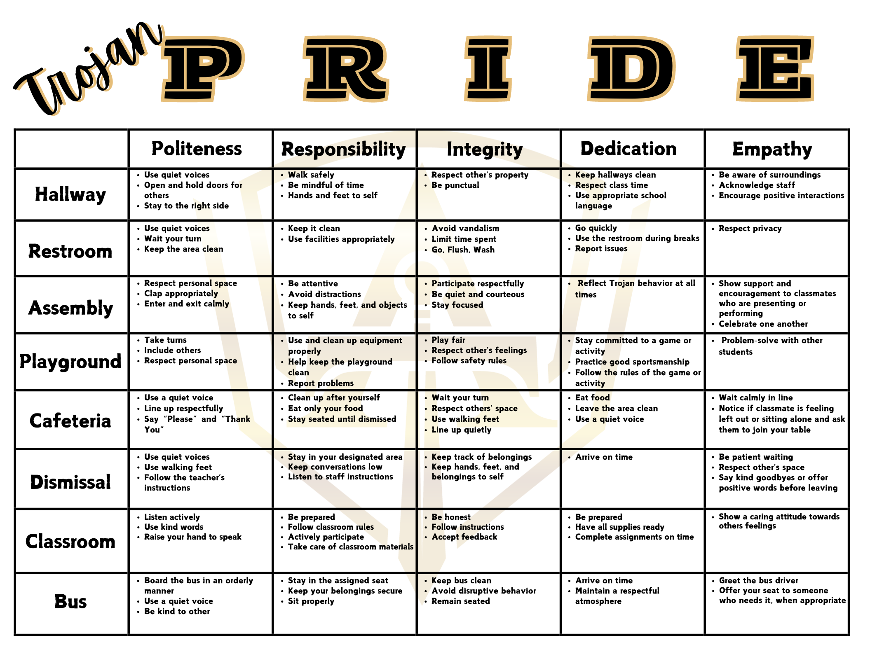
Student Code of Conduct
Trojan PRIDE Behavior Matrix
A behavior matrix is a simple, visual tool that clearly outlines school or classroom expectations in different settings (like the hallway, cafeteria, or playground). These matrices are important because they help students understand exactly what positive behavior looks like in each area, making expectations consistent and easy to follow.
They are effective because they:
Promote a positive and safe learning environment
Help reduce confusion and misbehavior
Support students in making good choices
Encourage accountability and consistency across all staff and settings
By teaching and reinforcing expected behaviors, behavior matrices help all students succeed—academically, socially, and emotionally.

Slide 16
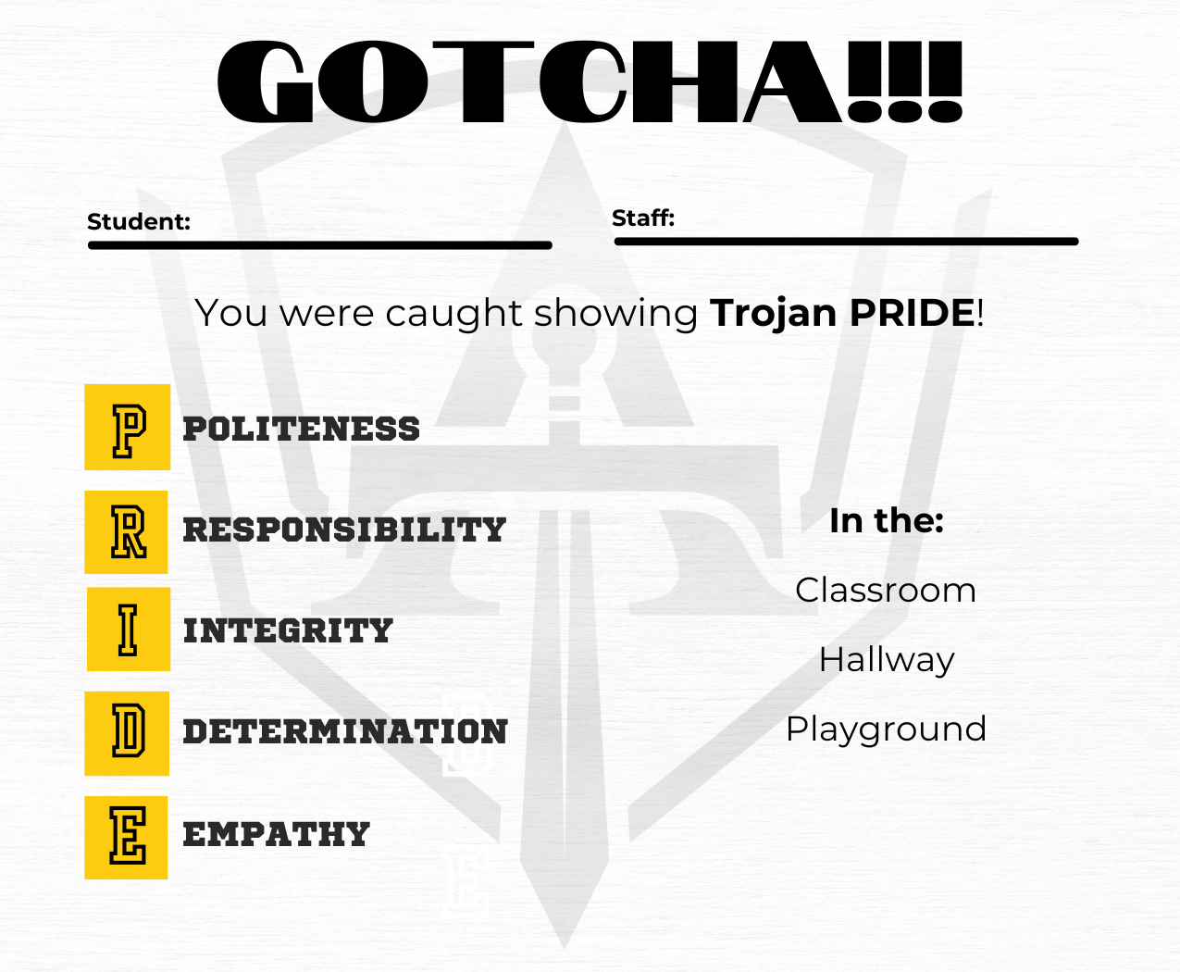
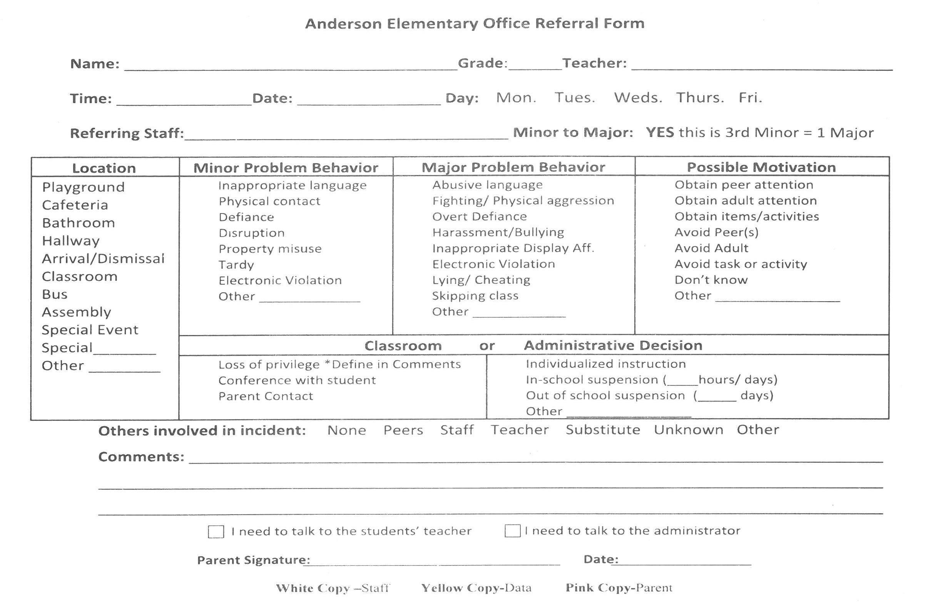
Student Code of Conduct
Universal Interventions and Discipline Referrals
Trojan PRIDE GOTCHA!!! Is a universal intervention used at Anderson to encourage expected behavior and positive student conduct.
When students receive a GOTCHA!!!, it means they are exhibiting positive behavior. Verbal praise should be given to the students to encourage this behavior. The pink copy of the GOTCHA is sent home with the student.
Politeness
Responsibility
Integrity
Dedication
Empathy
Office Discipline Referral Form (ODR)
ODRs are used to track problem behavior and disciplinary consequences. A student receives this form when he/she have NOT exhibited expected behaviors or desired student conduct. The pink copy of the ODR is sent home with the student.

Slide 17
Student Code of Conduct
Suspension Policy and Disrespectful Behavior
Student(s) violating Anderson’s Shield of Success expected behaviors and/or Student Code of Conduct at Anderson School or the associated parameters resulting in a Major Problem Behavior is subject to receive suspension as a disciplinary consequence from the Superintendent and/or Principal. Suspensions may consist of In School Suspension (ISS) or Out of School Suspension (OSS). DEPENDING ON THE INCIDENT, THE SUPERINTENDENT and/or PRINCIPAL HAS THE RIGHT TO OMIT ANY STEPS AND ADMINISTER PUNISHMENT DEEMED APPROPRIATE.
Following are some, but not limited to Disrespectful Behaviors that can and will result in immediate suspension:
Showing disrespect for, defying the authority of, and/or being insubordinate to a teacher, administrator, or any other school district staff.
Leaving school grounds or activities at unauthorized times without permission, refusing to identify or falsely identifying one’s self to school personnel and/or unauthorized entry into classrooms or other school premises.
Violating the school district, Student Code of Conduct rules, policies, or public law.
Possession or use of any firearm, weapon, object, electronic device, or substance that might be dangerous or injurious to person or property, including possession or use of fireworks.
Engaging in conduct which endangers or jeopardizes the safety of others.
Bullying, harassing, hazing, threatening, or verbally assaulting another student, faculty member, or other person.
Use of profanity, vulgar language, or expressions, and/or obscene gestures.
Assault and battery of, inflicting bodily injury on, or fighting with a student, faculty member, or other person.
Creating or attempting to create a classroom disturbance, acting in a disorderly manner, disturbing the peace and/or inciting, encouraging, prompting or participating in an attempt to interfere with or disrupt the normal education process.
Showing disrespect, causing damage, vandalizing, cutting, defacing, or destroying any property, real or personal, belonging to the school district, its employees, students, or visitors.
Use or possession of tobacco in any form while riding in school vehicles, on school grounds, or other school parameters.
Using, possessing, or being under the influence of, selling, transferring, distributing, or exchanging any alcoholic beverage, tobacco product, drug, or inhalant including vaping products.
Engaging in extortion, theft, arson, gambling, immoral behavior, forgery, possession of stolen property, and cheating in person or on an electronic device while on school property and associated parameters.
Possession, distribution, and/or accesses of pornographic materials, clothing, or websites electronically and/or in person.
Failure to fulfill assigned school discipline, comply with state immunization records, truancy, and/or falsely reporting an emergency, or interfering with emergency drills.

Slide 18
Student Academics
Process, Programs, and Policy
Cellular Devices
Anderson Public School will allow students to have cellular devices (not limited to: cell phones, smart watches, smart headphones, and smart glasses) on campus. However, the device must be turned off when they arrive in the morning and kept in their backpack until 3:15. Students will be allowed to turn their device on when they are leaving campus at the end of the day. There will be NO devices out in the building throughout the day or on the playground/common areas where students gather. If a student is seen with their device throughout the day it will be taken and kept in the office. The parent will be notified and the student can have the device back at 3:30. Repeated episodes will result in a conference between the parent, student, and school administration. We realize parents may need to contact or touch base with their child if an emergency arises during the day. Parents are asked to contact the school at 918-245-0289 and leave a message. The office will make sure information is shared with the child. If it is an extreme emergency a parent can call and the student can come to the office to receive a call.
Please review State Bill 139 for more information on state law forbidding cellular devices.
Retention Process
Some students are retained at their present grade level each year. This is a cooperative process carried on between the school and parents/guardians. Efforts are made to notify parents early in the second semester when retaining is imminent. By Oklahoma Law, the Superintendent has the authority to determine grade placement.
Gifted and Talented Program
The Anderson Gifted and Talented program serves grades 3 through 8. Student participants are served through both differentiated curriculum in the classroom and through learning laboratory programs. Student participants must qualify for the program by meeting certain criteria in compliance with Oklahoma State Law. An advocacy procedure has been developed which permits teachers and parents to recommend students for further evaluation and possible placement in the program. You are encouraged to contact the school Superintendent, Principal, or GT Coordinator if you have questions about the program.
Homebound Program
Homebound services are for children who are unable to attend classes due to physical illness (surgery, etc.) and who expect at least a two-week, consecutive absence.
Special Services Program
The mission of the Special Services/Special Education Program is to individualize the instruction and support of special education, based on specific identified needs for our students on an Individualized Education Plan (IEP) in order for them to achieve at their highest level. The focus of special education instruction is to create IEPs that drive our services. Anderson Public School believes in the philosophy of inclusion and follows the least restrictive environment guidelines recommended by the State Department of Education. A spectrum of services inside and outside the general education classroom help to bridge the learning gaps for special education students while building a strong sense of community. We strive to address areas of academic and other deficits through the use of research-based practices and curriculum to prepare our students for the future.
Student Conduct on Buses
See Student Handbook page 16

Slide 19
Student Academics
Progress, Programs, and Policy
Evaluation of Academic Progress
The school year is divided into four nine-week grading periods for which a progress report is made to parents. A student must be enrolled a minimum of 50% to receive a report for that nine-week period.
Progress reports will be sent to the home at the fifth week of each nine weeks. Special reports may be sent when a teacher feels a student is making unusually slow progress in a particular subject.
All students receive a report card every nine-weeks. The following evaluation marks are used for grades Pre-K, K, 1st and 2nd:
+ Skill Mastery
/ Presently developing skill
- Area of concern
[ ] Not evaluated at this time
The following is the grading scale used by grades 3 through 8:
90-100 A - Superior
80-89 B - Above Average
70-79 C - Average
60-69 D - Below Average
59 and below F - Unsatisfactory
Proficiency Based Progress
Proficiency based promotion is a system which awards credit for student’s knowledge in the core curriculum areas of mathematics, language arts, social studies, and science through an assessment process. The following outlines the procedures that will be used to allow students the opportunity to progress through the program.
All students in grades 1-8 enrolled at Anderson School are eligible for the Proficiency Based Program.
Upon request of a student, parent, guardian, or educator, a student will be given the opportunity to demonstrate proficiency in one or more of the core curriculum areas.
In order for a student to participate in the program, a student must perform at 97% or greater level on a Test of Basic Skills.
Students demonstrating proficiency in one or more curriculum areas will be given credit for their learning and will be given the opportunity to advance to the next level of study in the appropriate curriculum areas.
Students not demonstrating proficiency will be allowed to try again during the next assessment period.
Students may advance one or more levels in the core curriculum areas, However, they must progress through a curriculum areas in sequential manner.

Slide 20
Student Academics
Homework Policy
Please discuss with your student’s classroom teacher any homework or make-up work preferences specific to your students’ class.
Homework is used for reinforcement, make-up, and/or completion of unfinished classroom assignments.
A student should strive to work hard at school; therefore, less homework will be necessary, and the student will have more time for extracurricular activities and family involvement.
Homework is the student’s responsibility. Students may share this work with their parents and seek help when needed, but should be completed by the student.
All assignments should be carefully and neatly prepared and turned in on schedule.
Absentee homework: When you are absent for a length of time, please call the school and speak to the Student Information Secretary and email each teacher. Teachers will have your assignments ready at the office to be picked up.
Planned absences require planned make up work. Assignments should be gathered before you leave for your event, and the work is due the day you return to school.
Students who are absent will have the same number of days to make-up work as days they were absent. It is the student’s responsibility to make arrangements for any make-up work upon returning to school.

Slide 21
Student and Family Rights
FERPA and IDEA
Family Education Rights and Privacy Act (FERPA) of 1974
Statement of Rights
Parents and eligible students have the following rights under the
Family Educational Rights and Privacy Act
The right to inspect and review a student’s education record.
The right to exercise a limited control over other people’s access to the student’s education record.
The right to seek to correct the student’s education record; in a hearing if necessary.
The right to report violations of the FERPA to the Department of Health, Education, and Welfare.
The right to be informed about FERPA rights.
All rights and protections five parents under the FERPA and this policy transfer to the student when he or she reaches age 18 or enrolls in a post-secondary school. The student then becomes and “eligible student”.
The Uninterrupted Scholars Act (Public Law 112-278) was enacted on January 14, 2013. The Act amends FERPA to permit educational agencies and institutions to disclose a student’s education records, without parental consent, to a caseworker or other representative of a State or local child welfare agency or tribal organization authorized to access a student’s case plan “when such agency or organization is legally responsible, in accordance with State or tribal law, for the care and protection of the student.”
A copy of the FERPA policy is available for review in the Superintendent’s office.
For more inrformation see policies FL and FL-R
Individuals with Disabilities Education Act - IDEA (2004)
IDEA states that ALL children have the right to a Free and Appropriate Public Education (FAPE)
The Anderson Public School district is searching for children, birth through twenty-one years of age that may be in need of special services.
If you think a child may have a disability or a special need, call the school district at (918)245-0289. All information is kept confidential.

Slide 22
Student Information
Food Services
Anderson School participates in the National School Lunch Program
Student
Breakfast………………….$ 1.70
Lunch…………….………….$ 3.25
Student Reduced
Breakfast………………….$ .30
Lunch…………….………….$ .40
Adult
Breakfast………………….$ 2.94
Lunch…………….………….$ 5.15
*Adult Guest prices are subject to change
Prices are reflective of the National School Lunch Program
This institution is an equal opportunity provider
We will serve free and reduced priced meals to children whose families fall within the state guidelines. Guidelines and applications may be made through the school office.
Those children buying their lunch at regular or reduced prices are required to purchase lunch credits in advance in the school office or online. We have a no charge policy
Family members or guardians planning to join their student(s) for lunch must check in at the office and are encouraged to inform the classroom teacher ahead of time. To confirm your child’s schedule, please contact the school office or the classroom teacher.

Slide 23
Student Information
School Visitors and Observations
Visitors
Safety is a PRIORITY at Anderson School. Be advised families or visitors are NOT to go directly to a student’s classroom or be on school grounds without first checking in with the office. All approved visitors MUST wear a visitors tag while on school grounds.
If you are here to visit with a teacher, other school employee, or attend a conference, meeting, etc., you MUST sign in at the office. Please remain in the office until your child has arrived or until you receive a visitors badge and are cleared to be in the building by office staff.
Classroom Visitation by Parent/Legal Guardian
Regular Education Classrooms
All visitations must be scheduled and approved by the Superintendent. To minimize disruption, a parent or legal guardian may visit classrooms under these circumstances:
To attend a class function such as a party or play
To have a conference with the teacher in the classroom when other students are not present
To make classroom observations during instruction time, requests must be made in writing and delivered to the Superintendent at least forty-eight hours prior to visiting the classroom. All observations will be at the Superintendent’s discretion, and if allowed, must occur within the following guidelines.
An administrator must accompany the parent or guardian for a period not to exceed twenty minutes.
Observations will not be scheduled during achievement testing or any other activity that could be disrupted by the presence of visitors in the classroom.
No recording equipment or cameras will be permitted in the classroom during an observation of the instructional process unless prior permission has been given by the Superintendent.
Special Education Classrooms
The provisions of the above policy pertain to special education classrooms; however, due to confidentiality requirements, a written request to make an observation in the classroom, on forms provided by the school district, must be made in writing and delivered to the Superintendent at least forty-eight hours prior to visiting the classroom. All observations will be at the Superintendent’s discretion, and if allowed, must occur with a confidentiality release from parents or legal guardians of other children in the classroom. This is required.

Slide 24
Student Information
Conferences & General Information
Conferences
Communication between parents/guardians, the student, and teachers is encouraged. The proper communication procedure begins with first contacting your child’s teacher. If a resolution is not satisfactorily met, then a meeting with the parent, teacher, counselor, Principal, and/or Superintendent may be necessary. If a student wishes to see the principal, they may ask their teacher and a meeting will be scheduled. If a parents desires a conference, please call the Student Information Secretary at (918)245-0289 for an appointment.
Under no circumstances should a conference take place during a school day when a teacher is conducting class or supervising children on the playground. After school drop in conferences are discouraged. Conferences with teachers are scheduled by appointments made through the Student Information Secretary or by written consent of the classroom teacher.
Parent/Teacher Conferences are scheduled for the Fall and Spring of each school year. Please see the school calendar for exact dates.
Meet and Greet is held at the beginning of the school year so that all parents have the opportunity to meet with their child’s teachers.
General Information
Lost and Found
Any items left lying around will be placed in the Lost and Found box. In order to ensure your items are returned, please label all items of clothing and lunch pails with your child’s name. Articles not claimed will be given to a charitable organization at the end of each school year.
Money
Students turn money into the office in a sealed envelope with the student’s name, classroom teacher, and purpose of the money written on the outside. Students should NOT leave money in lockers or in desks. The school is not responsible for any money stolen during school. All money is turned into the office every day, and is not kept onsite overnight.
Library Media Center
Students are responsible for books checked out from the library media center. Lost books and badly damaged books must be replaced. A list of expectations is posted in the Library Media Center.
Lost/Damaged Books
Text books or library books that have been lost or damaged must be paid for in full. Workbooks are purchased by the school, and are to be left at the school if you move. Records will not be released until all books are returned and fees are satisfied.

Slide 25


Slide 26
Student Health
Medications, Illness, and Head Lice
Medications at School
The school will dispense medication upon written request. If possible, parents are advised to give medication at home, and on a schedule other than during school hours. Otherwise, the following regulations must be followed:
An “Authorization to Administer Medication” form must be completed, signed, and on file in the school office.
Medication must be brought to school in the original container - both prescription and nonprescription medication with original labels intact. If medication is not properly labeled, it will not be given.
PARENTS MUST SUPPLY ALL MEDICATION. The school CANNOT supply anything. We strongly recommend that the parents deliver all medications to the office. This eliminates lost medication on the bus or in the classroom. It also protects the ones it is intended for. A medicine that helps one student can be extremely harmful to another. Students should not keep medication with them at the school for this reason.
All medication is kept in the office in a locked cabinet.
Illness at School
Students with a temperature of 99 degrees or above must be sent home. Parents/guardians are asked to keep students who have elevated temperatures home 36 hours AFTER the temperature returns to normal without the aid of medication.
Students who vomit or have diarrhea while at school will be sent home, and should not return until they are symptom-free for a minimum of 36 hours.
Students who have a fever, vomit, or diarrhea during the previous evening or night should NOT be sent to school the next day.
Parents MUST provide transportation home for students who become ill at school promptly.
Head Lice Procedures
If you suspect your student has head lice, please contact the school to confirm it. Head lice are easily spread and will not disappear without the student being treated and all nits removed.
No student will be admitted to class who has lice, regardless of the number of treatments or measures that may have been taken.

Slide 27
Student and Family Rights
ESSA and School Board
ESSA
Congress passed the Every Student Succeeds Act (ESSA) in December of 2015. It is the main law for K–12 public education in the United States, and it affects all students in public schools. It replaced No Child Left Behind.
The main purpose of ESSA is to make sure public schools provide a quality education for all kids. ESSA gives states more of a say in how schools account for student achievement. This includes the achievement of disadvantaged students. Under ESSA, states get to decide the education plans for their schools within a framework provided by the federal government. For more information on ESSA or to see the full law, go to:
https://www.ed.gov/essa?src=rn
School Board Meetings and
The Process for Addressing Concerns
Meetings are normally held on the second Monday or Tuesday of each month, at 6:00 P.M. in the school library. Agendas are posted prior to the day of the meeting on the school’s main door and our website. Parents and patrons are welcome to address their concerns to the Board, but must follow the guidelines listed below.
Patrons must first discuss their concerns with the Superintendent.
Patrons will need to make a written request two days prior to the posting of the agenda of the regularly scheduled Board Meeting.
Patrons will be allowed a maximum of three minutes to address their concerns during the meeting.

Slide 28
Anderson Public School
Title 1 Parent/School Compact Agreement
Anderson Elementary School and the parents of the students participating in activities, services, and programs funded by Title I, Part A of the Elementary and Secondary Education Act (ESEA), agree that this compact outlines how the parents, the entire school staff and the students will share the responsibility for improved student academic achievement. It describes the means by which the school and the parents will build and develop a partnership that will help achieve high academic standards.
As a student I will:
Complete my assignments in class and turn them in on time.
Attend school regularly.
Ask for help when I do not understand.
Follow school rules.
Give my best EFFORT in all I do.
Complete and return homework assignments in a timely manner.
As a parent I will:
See that my child is punctual and attends school regularly.
Support the school in its effort to maintain proper discipline.
Establish a quiet time and place for homework and review it regularly.
Provide the school with a way to contact me.
Listen to my child read and let my child see me read.
Respect the school, staff, students and families.
Uphold Anderson Pubic School District policies according to the handbook.
As a staff member I will:
Provide all students with high quality teaching.
Provide a safe and challenging learning environment.
Welcome the involvement of parents.
Work with students who learn at different rates and in different ways.
Communicate regularly with families about student progress.
Work collaboratively with other professionals to ensure student success.
Respect the school, staff, students and families.
Attend Professional Development to increase “Best Teaching Practices.”
Uphold Anderson Public School District policies according to the handbook.

Slide 29
Anderson Public School
Miscellaneous
For more information on the policies and procedures outlined below please see the appropriate policy as indicated. Specific policy requests can be made to the Principal or Superintendent.
*Student Surveys/HATCH Amendment: EK-R1
*Parent Bill of Rights: EHBDBA
*Dress Code: FNCA
*Student Discipline: FO
*Student Suspension: FOD, FOD-R
*Student Searches: FNF
*Cell Phones and Personal Digital Devices: FNG
*Student Drug Testing: FNCFD
*Extracurricular Activities: FMA

